Slide 1
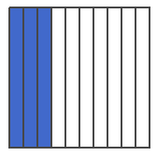

Name__________________________________
Homework Monday 6/4– Decimals
Show $\frac{8}{10}$ by shading the model.
What is the value of g on the number line? Write your answer as a decimal?
What is the standard form of the number:
$$\left(2×10\right)+\left(5×1\right)+\left(4×\frac{1}{10}\right)+\left(6×\frac{1}{100}\right)$$
Which decimals are greater than the one shown in this diagram? Check all that apply.
0.33
0.1
0.2
0.29
0.4
Put these decimals in order from least to greatest:
_____ _____ _____ _____ _____
7.68 7.3 7.35 7.8 7.08

Slide 2
Which comparisons are correct? Check all that apply.
0.56 <0.65
4.5 < 4.50
7.87 > 7.78
3.50 = 3.05
What is the sum of $\frac{4}{10}$ and $\frac{8}{100}$? Write your answer as a decimal.
Mary and Derek were collecting leaf samples from their backyards. Mary’s first leaf was 2.5 inches. Derek’s leaf was 2.45 inches. Who had the longer leaf? Write a comparison using <, >, or =.
Of the 100 people at a Super Bowl Party, 40 are there for the game, 20 are there for the commercials and the rest are there for the food. Write a fraction and decimal to represent each of the following groups of people:
Game: Commercials: Food:
Which decimal is less than 0.46?
0.64
0.4
4.6
4.4

Slide 3
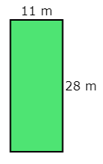
Name_______________________________________
Homework Tuesday 6/5- Area & Perimeter
What is the perimeter of the rectangle?
The area of the rectangle is 135 squared inches. What is the length of the missing side?
Aubrey hung a rectangular dry erase board which is 18 inches by 9 inches. What is the area of the dry erase board?
Loreen's bedroom is square-shaped. One side of the room is 13 feet long. What is the perimeter of Loreen's bedroom?

Slide 4
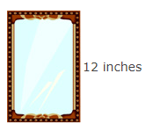
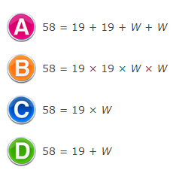
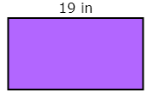
The area of small rectangular mirror is 48 squared inches.
a) What is the length of the missing side?
b) What is the perimeter of the mirror?
6. The perimeter of the rectangle is 58 inches. The length of the rectangle is 19 inches. Which equation can be used to find the width, W, of the rectangle, in inches?

Slide 5
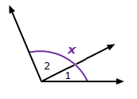
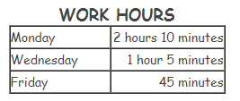
Name______________________________________
Homework Wednesday 6/6- Conversions & Angles
The measure of angle 1 is 27 degrees. The measure of angle 2 is 86 degrees, What is the value of x, the measure of the whole angle?
Kourtney works part-time helping students with math homework. She worked Monday, Wednesday, and Friday last week. How much time, in minutes, did Kourtney work last week?
Which is more, 1 liters or 1,425 grams?
Thomas dropped off two packages to be shipped. One package weighed 2 kilograms and the other package weighed 720 grams. How much did the two packages weigh altogether?

Slide 6
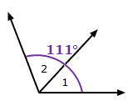
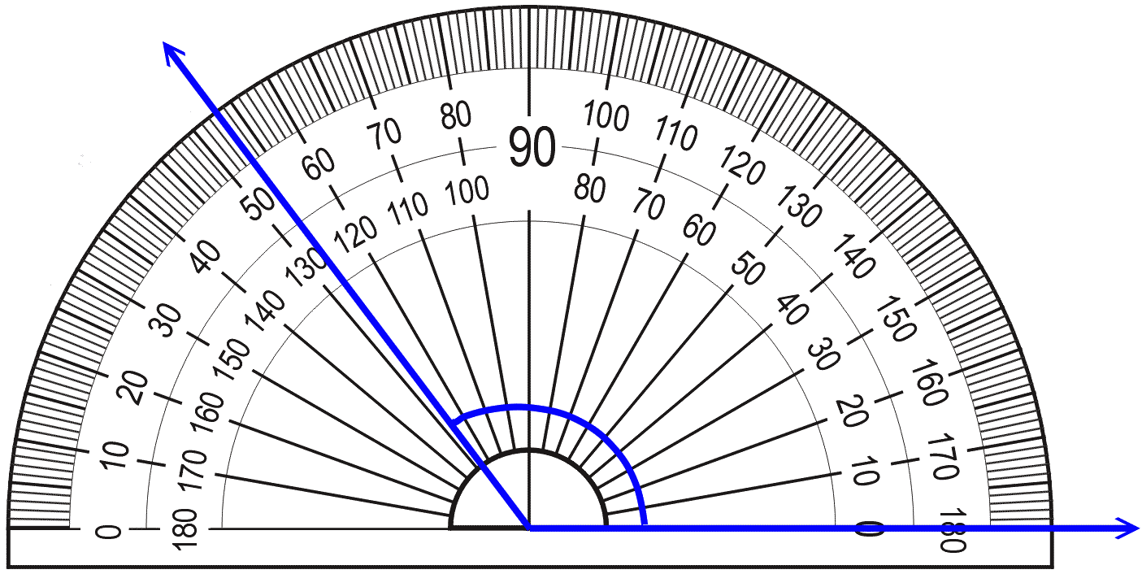
The measure of angle 1 is 47 degrees. What is the measure of angle 2?
What is the measure of the angle?
Choose the appropriate measurement for the following item:
 | A | B | C
Slice of Bread | 4 inches | 4 feet | 4 yards
Running a Marathon | Inches | Yards | Miles
Height of an Oak Tree | Centimeters | Meters | Kilometers
Distance from New York to California | 4,700 centimeters | 4,700 meters | 4,700 kilometers

Slide 7
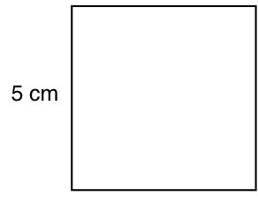

Name___________________________________
Homework Thursday 6/7- Review
Which comparison is incorrect?
A. 5.41 > 5.14
B. 6.40 = 6.4
C. 1.7 < 1.71
D. 0.48 < 0.4
Which of the following are equivalent to $\frac{70}{100}$? Choose all that apply.
0.70
0.07
0.7
0.007
7.0
A square picture frame is shown below.
A. What is the area of the frame?
B. What is the perimeter of the frame?

Slide 8
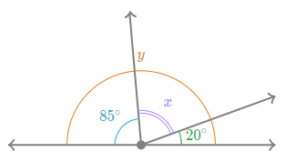
A sunflower grew 8 inches last month and 2 feet this month. How many total inches has the sunflower grown in the past two months?
What is the measure of angle x?
Which shape is not symmetrical?
A. B. C. D.
7. Select true or false for the following statements.
This shape has exactly 1 set of parallel sides | True False | This shapes has 4 right angles. | True False

